Slide 1


Topic :- Physical properties and
molecular structure - II
Mr. Ajit K. Dhas
Department of Chemistry Deogiri College
Aurangabad

Slide 2
B. Sc. III (V Semester) Physical properties and molecular structure - II

Slide 3
Physical properties and molecular structure
Contents:
Magnetic property and its measurement by Guoy balance method,
Magnetic property for determination of structure of molecule.

Slide 4
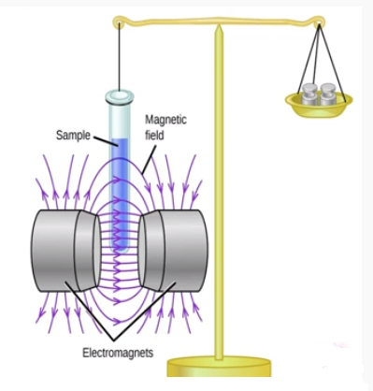
Gouy’s balance

Slide 5
Magnetic property and its measurement by Guoy balance method:
Steps in the measurement :
Finely powdered substance or solution is taken in a glass tube called as Gouy’s tube.
Measure the weight of the substance in absence and in presence of magnetic field.
Observation:
If the substance is paramagnetic then it will weigh more than in absence of field. Increase in weight is the measure of paramagnetism of the substance.

Slide 6
Advantages of Gouy’s method:
Apparatus is simple and easy to assemble.
Apparatus is easy to handle.
Chemical balance can measure change in mass. Large amount of sample have large forces.

Slide 7
Disadvantages of Gouy’s method:
Large amount of sample required for analysis.
If sample is not uniformly filled in sample tube then it leads to error in the measurement of the magnetic property.

Slide 8
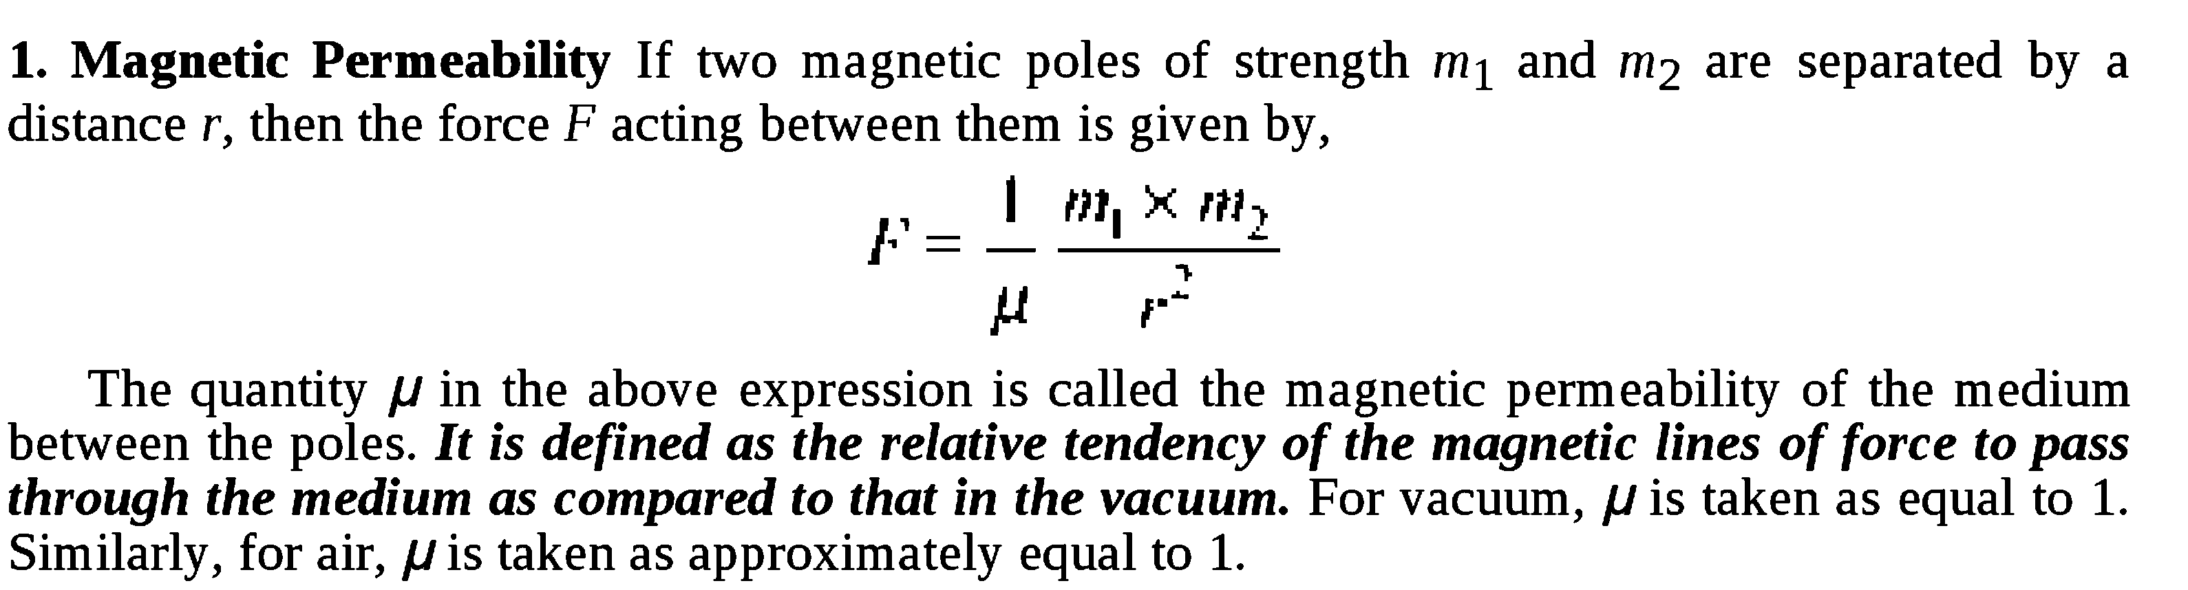

Slide 9
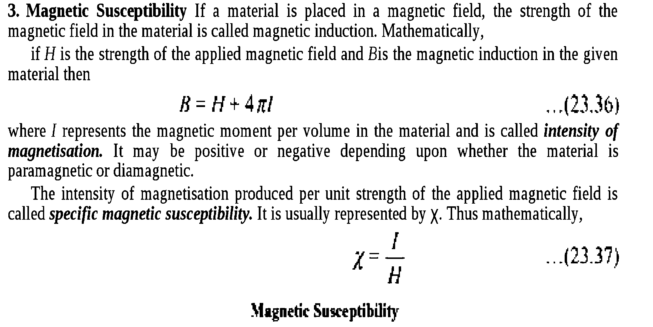

Slide 10
Difference between paramagnetic, diamagnetic and ferromagnetic substances.
PROPERTIES | FERROMAGNETIC MATERIALS | PARAMAGNETIC MATERIALS | DIAMAGNETIC
Physical State | They are solid. | They can be solid, liquid or gas. | They can be solid, liquid or gas.
Effect of Magnet | Strongly attracted by a magnet. | Weakly attracted by a magnet. | Weakly repelled by a magnet.
Behavior under non-uniform field | tend to move from weaker to strong field. | tend to move from weaker to strong field. | tend to move from strong to weak field.
Behavior under external field | They preserve the magnetic properties after the external field is removed. | They do not preserve the magnetic properties once the external field is removed. | They do not preserve the magnetic properties once the external field is removed.
Effect of Temperature | Above curie point, it becomes a paramagnetic. | With the rise of temperature, it becomes a diamagnetic. | No effect.
Permeability | Very high (of the order 10³) | Little greater than one (˃ 1 ) | Little less than unity (˂ 1 )
Susceptibility | Very high and positive | Little greater than unity and positive | Little less than unity and negative
Examples | Fe, Co, Ni | Li, Ti, Mn, Al, Mo, Cr, Zr | Cu, Au, Ag, Si, Zn

Slide 11
Magnetic property for determination of structure of molecule:
On the basis of magnetic susceptibility value we can decide magnetic nature of the substance that helps us to find out unpaired electrons in the atom.

Slide 12
Thank You…

