Slide 1
JOINTS
Dr. A.V.Tejankar
Professor & Head
Dept. of Geology
Deogiri College, Aurangabad

Slide 2
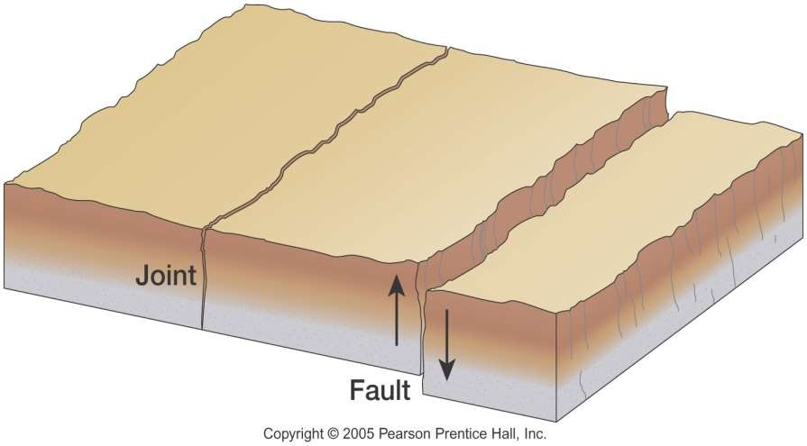

Effects of Joints
From the civil engineering point of view, joints are important because they split the rocks into a number of pieces which, in turn, reduce the competence of rock mass, increase the porosity and permeability and make them susceptible to quick decay and weathering.
Joints But a few advantages that accompany joints are; their occurrence increases the ground water potential in any place.

Slide 3
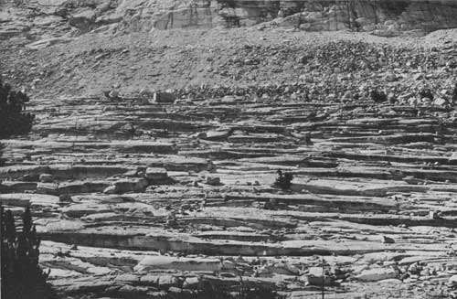
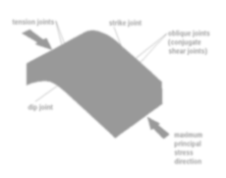

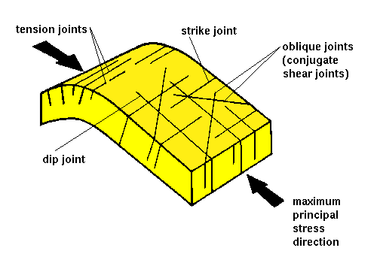

Slide 4
Joints,
though
they resembles
faults by
Appearing as fractures in rocks, are not as dangerous as faults. This is so primarily because
the region affected by joint are not liable to
recurrence of joints in future as happens in the case of faults. Thus places where joints occur are
not very unstable for foundation purpose. Also the area affected by joints can be easily improved by methods such as suitable cement grouting or plugging.

Slide 5
Parts of a Joint
Joints like faults, refer to the fracture in rocks. Hence, like faults, inclined and vertical joints also can be described by their attitude.
However, in joints the fracturing blocks are not named as footwall or hanging wall.

Slide 6
Types of Joints
Strike Joint
Dip Joint
Oblique Joint
Tension Joint
Shear Joint

Slide 7
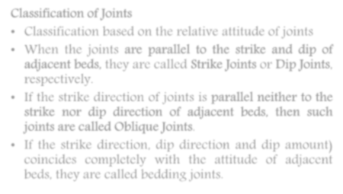
Classification of Joints
Classification based on the relative attitude of joints
When the joints are parallel to the strike and dip of adjacent beds, they are called Strike Joints or Dip Joints, respectively.
If the strike direction of joints is parallel neither to the strike nor dip direction of adjacent beds, then such joints are called Oblique Joints.
If the strike direction, dip direction and dip amount) coincides completely with the attitude of adjacent beds, they are called bedding joints.

Slide 8

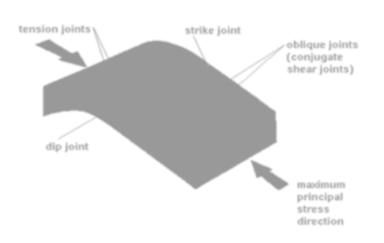
Classification of Joints

Slide 9
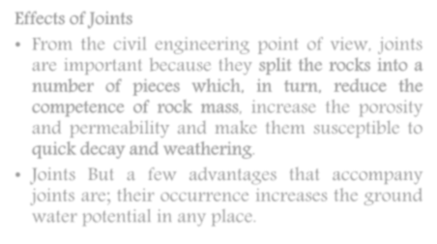
JOINTS
Effects of Joints
From the civil engineering point of view, joints are important because they split the rocks into a number of pieces which, in turn, reduce the competence of rock mass, increase the porosity and permeability and make them susceptible to quick decay and weathering.
Joints But a few advantages that accompany joints are; their occurrence increases the ground water potential in any place.

Slide 11
Joints,
though
they resembles
faults by
appearing as fractures in rocks, are not as dangerous as faults. This is so primarily because
the region affected by joint are not liable to
recurrence of joints in future as happens in the case of faults. Thus places where joints occur are
not very unstable for foundation purpose. Also the area affected by joints can be easily improved by methods such as suitable cement grouting or plugging.

Slide 12
Parts of a Joint
Joints like faults, refer to the fracture in rocks. Hence, like faults, inclined and vertical joints also can be described by their attitude.
However, in joints the fracturing blocks are not named as footwall or hanging wall.

Slide 13
Types of Joints
Strike Joint
Dip Joint
Oblique Joint
Tension Joint
Shear Joint

Slide 14
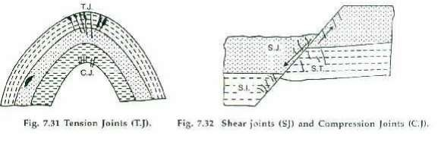

Slide 15
Classification of Joints

